Slide 1
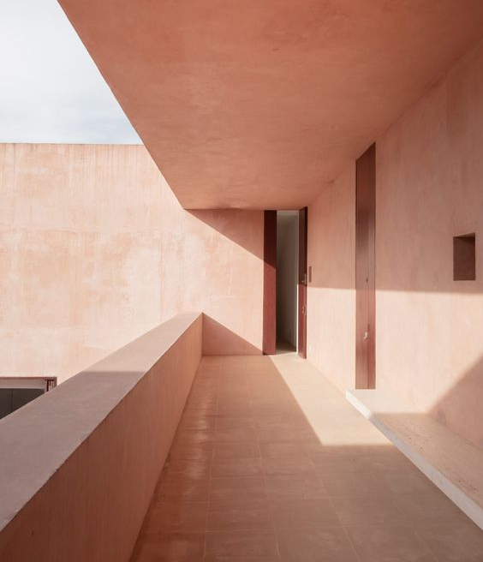
Neuendorf House
Massimo loverso
S8094455

Slide 2
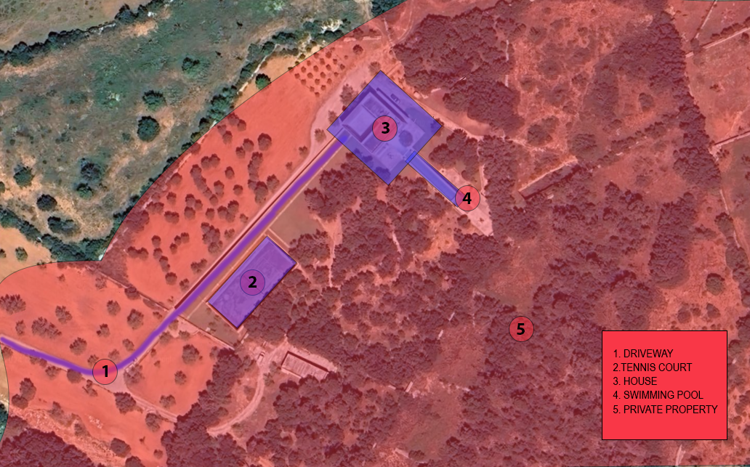
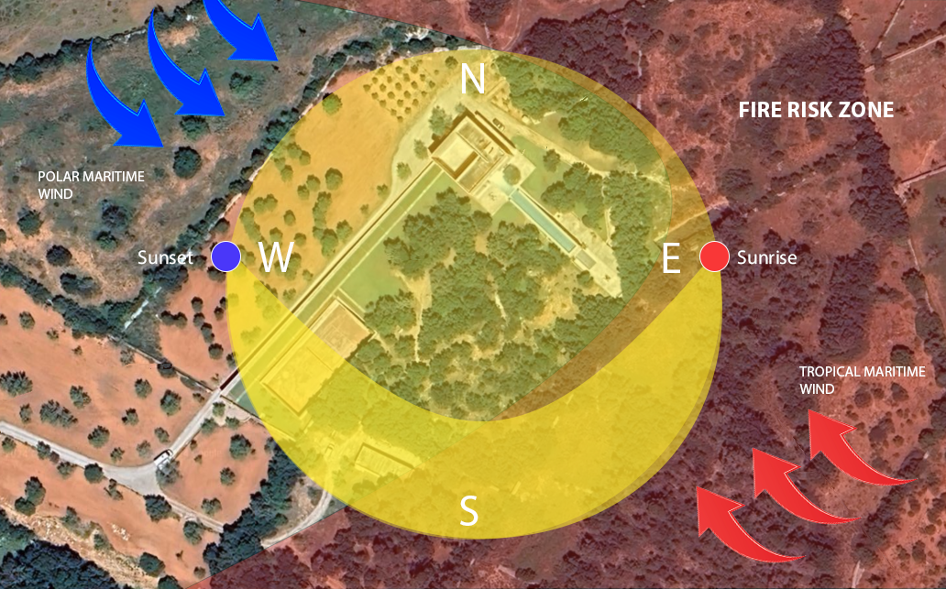
Site Analysis
The Neuendorf house is located in Mallorca Spain. The house is situated along a private road , surrounded by a large density of trees on a large block of land.
Mallorca experiences a year-round variety of weather due to its climate. A combination of Mediterranean and various air masses, such as subtropical marine, continental, and polar influences.

Slide 3
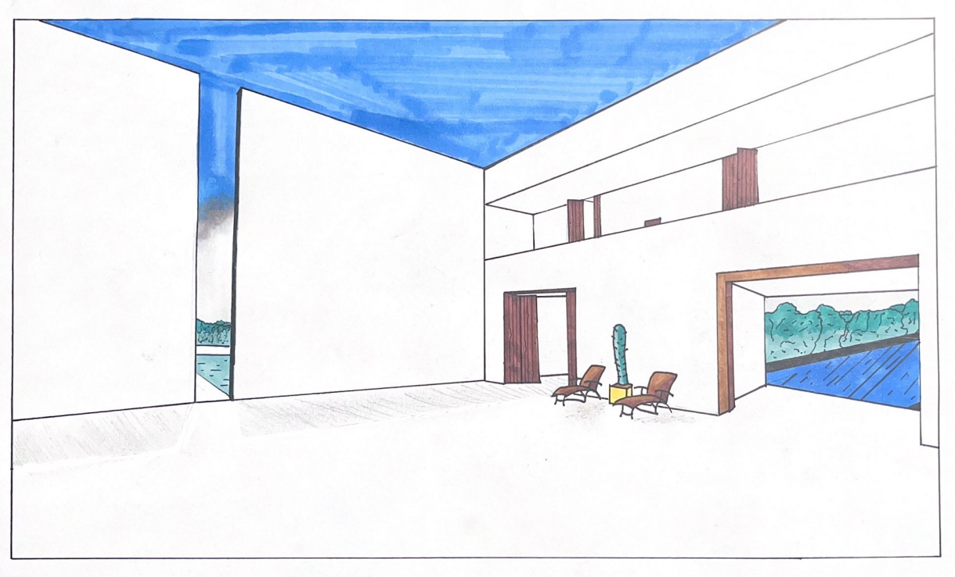
Perspective drawing

Slide 4
Model Takeoff notes
Materials
Plan
Process
Product | Quality | Cost
Boyles Clear Craft Glue | 1 | $9.49
Flat brown Carboard | 8 | $0 (From Work)
A1 Foam Board 5mm | 1 | $9.54
Deciduous Trees 38mm | 4 | $18.99
Stanley Knife | 1 | $0 (already owned)
Texters | - | $0 (already owned)
Ruler | - | $0 (already owned)
Pencils | - | $0 (already owned)
Cut brown Carboard to shape of topography for base.
Glue the layers of carboard onto each other
Using Stanley knife Cut Pannels from Foam board of each section of the house
Assemble using clear craft glue
Use texters to outline key features, pool and tennis court
TSA: Actions may very when process is being undergone.
 | Date | Status
Materials collected | 28/03/2024 | complete
Base has been created | - | -
House panels have been cut out | - | -
Glueing process | - | -

Slide 5
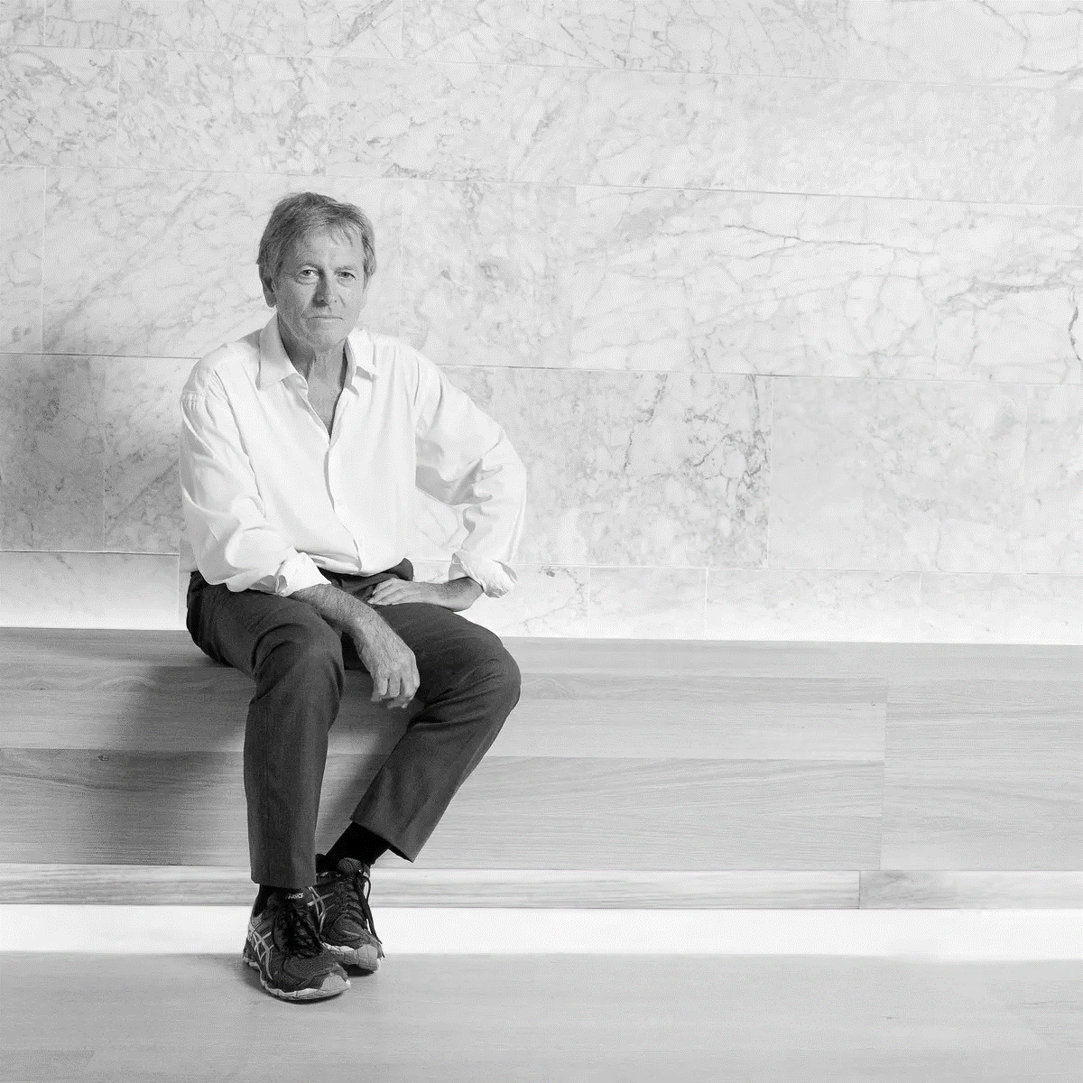
Group Theme (John Pawson, minimalism)
Complexity of minimalism
Our group chose John Pawson and minimalism, in particular I was inspired by the elegance of his well-known projects, Neuendorf House. Pawson's thinking of simplicity is demonstrated in his design. The Neuendorf House along with many other projects inspired our desire to follow his aesthetically pleasing and functional designs. Minimalism offers clarity with space, By using Pawson's minimalist aesthetic, we want to recreate these spaces that are not only visually stunning but also meaningful and beneficial to the human experience.
Figure 1.4: (N.d.). Retrieved from https://i.guim.co.uk/img/media/9a781c432346b407d6b1d70bcc190de0f2cb3d08/0_428_5039_3024/master/5039.jpg?width=1200&height=1200&quality=85&auto=format&fit=crop&s=8ddabf4ecef36525f386000e135b53d5

